Slide 1
“We Are….
HOSA”

Slide 2
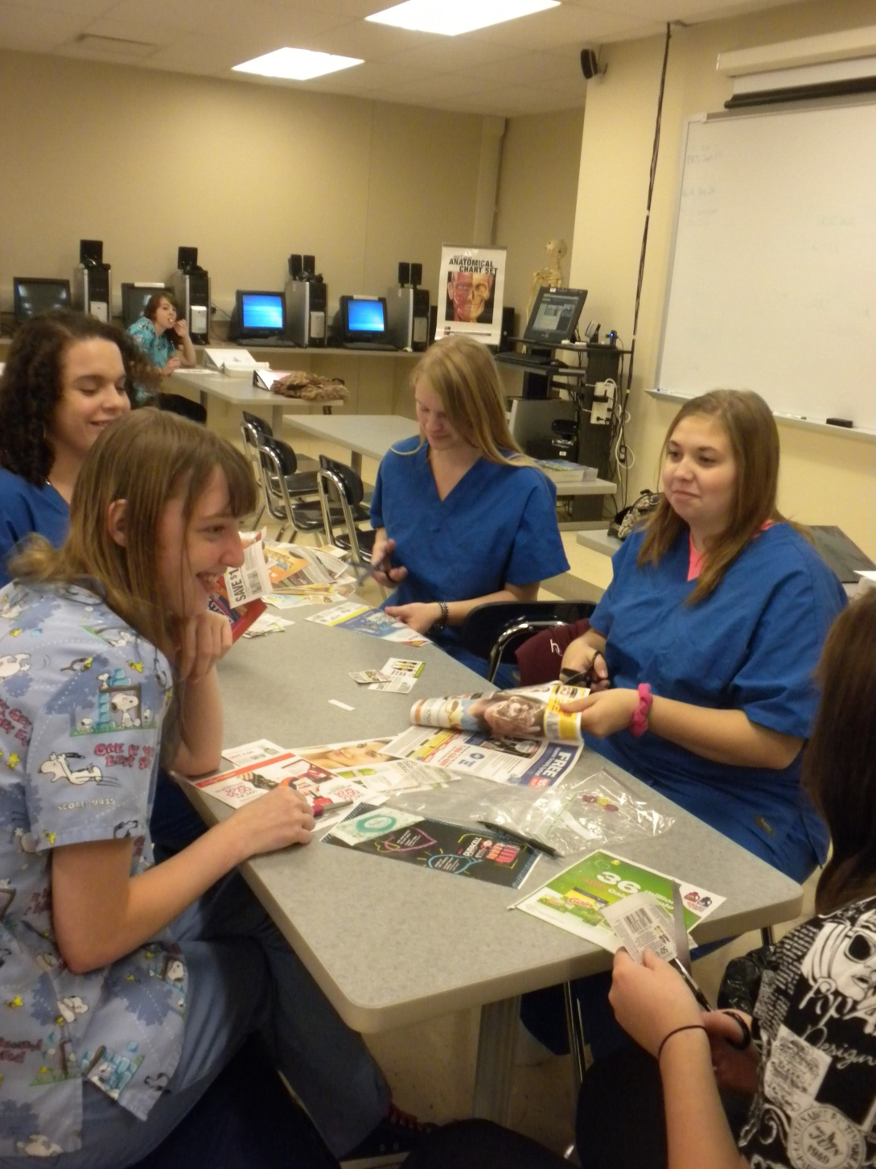
Coupons for Troops

Slide 3
Sharing the love

Slide 5
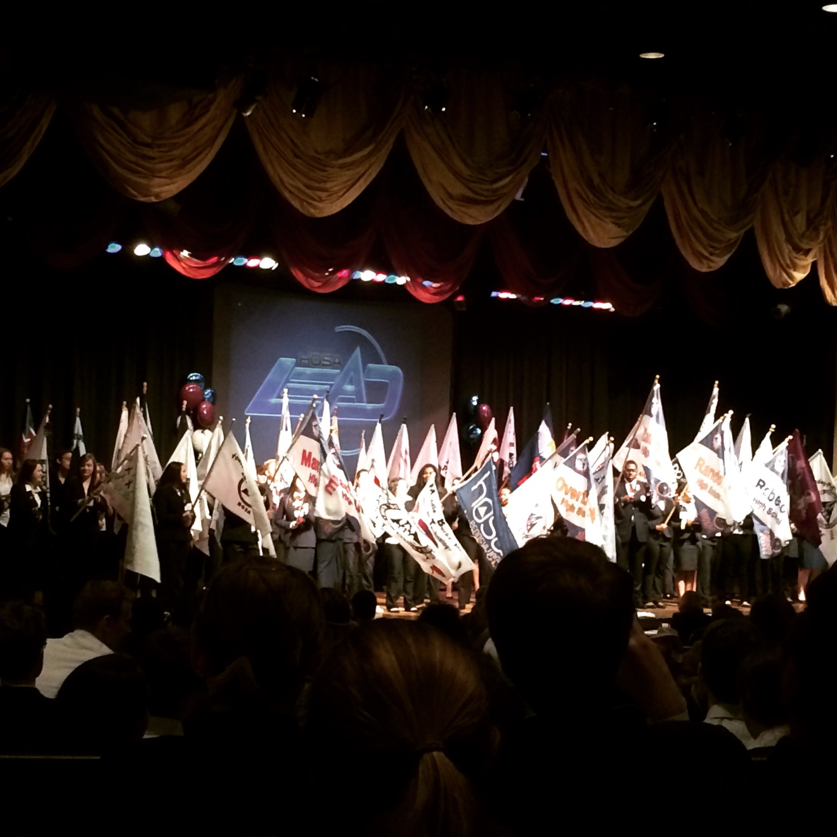
Parade of Chapters at State Leadership Conference
Parade of Chapters at State Leadership Conference

Slide 6
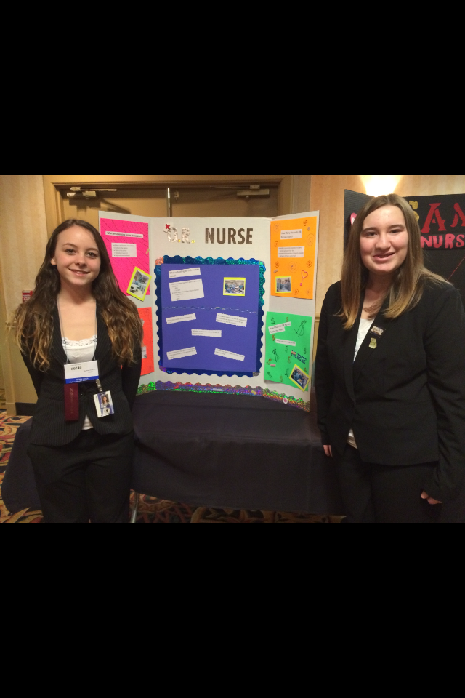

Slide 7
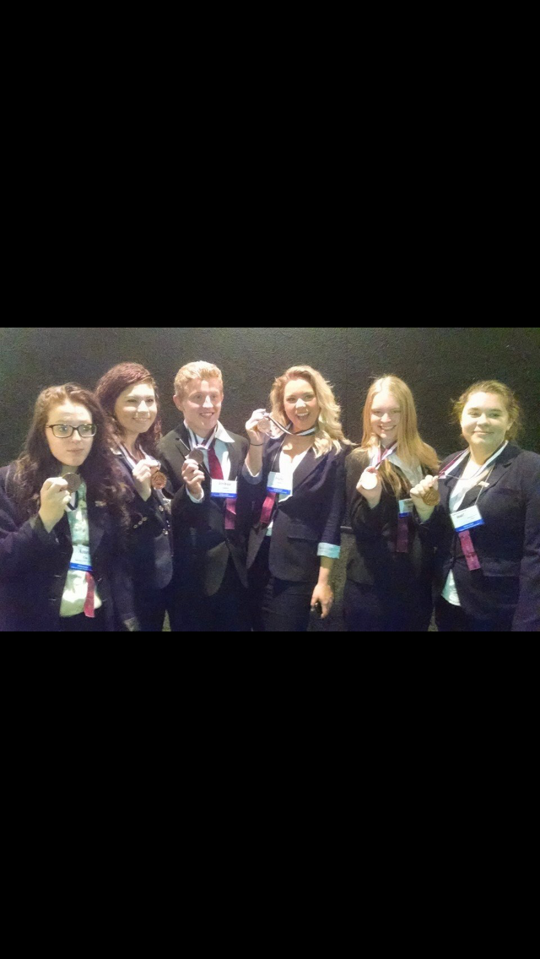
HARD WORK REWARDED

Slide 8
30th Annual National Leadership Conference Anaheim, CA 2015

Slide 10
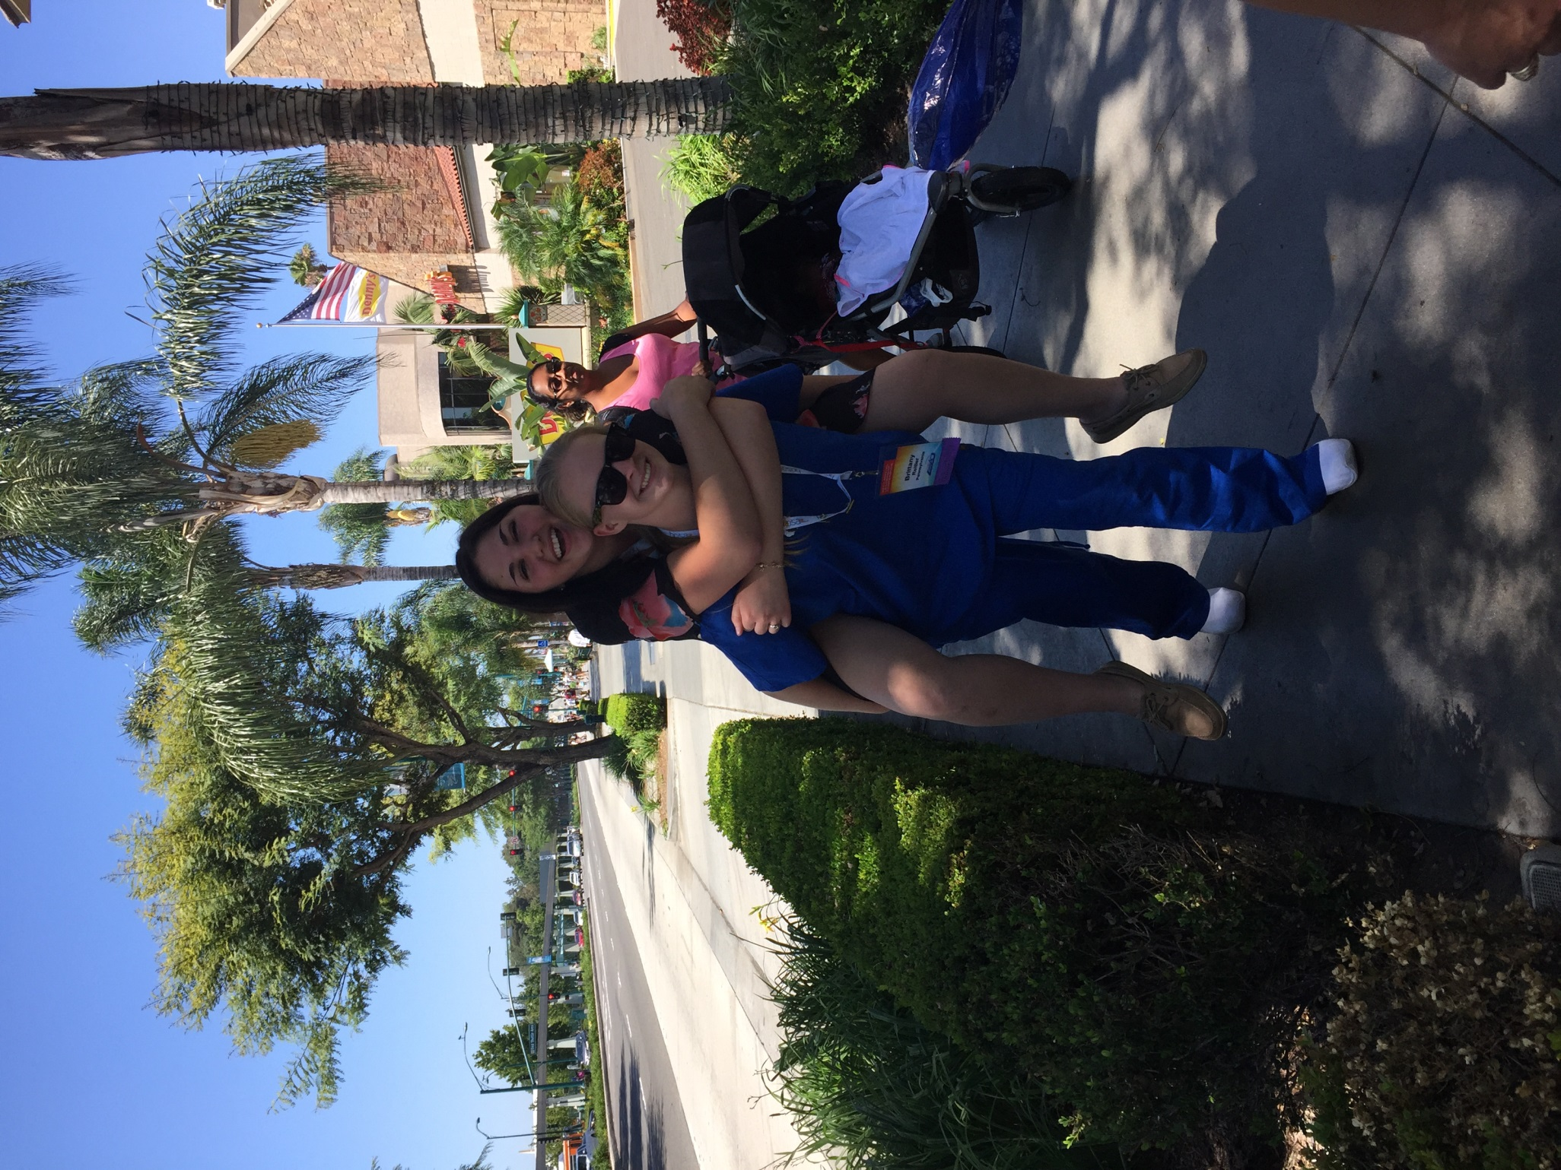
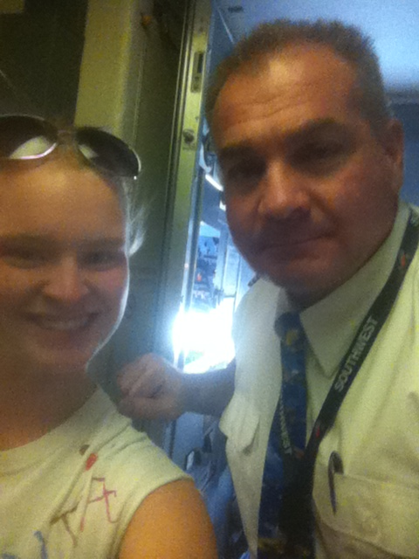

Slide 11
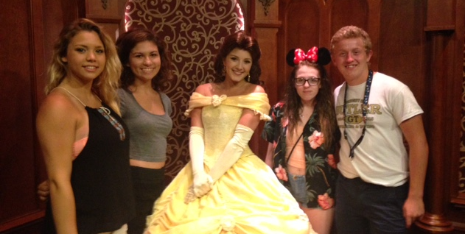
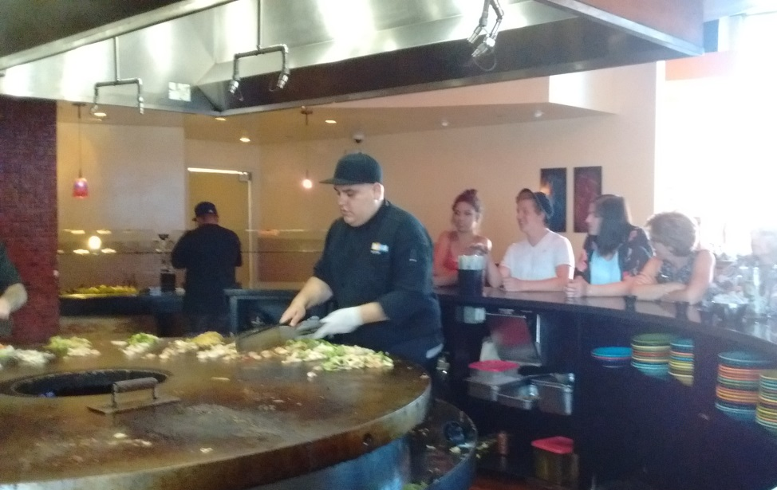

Slide 13
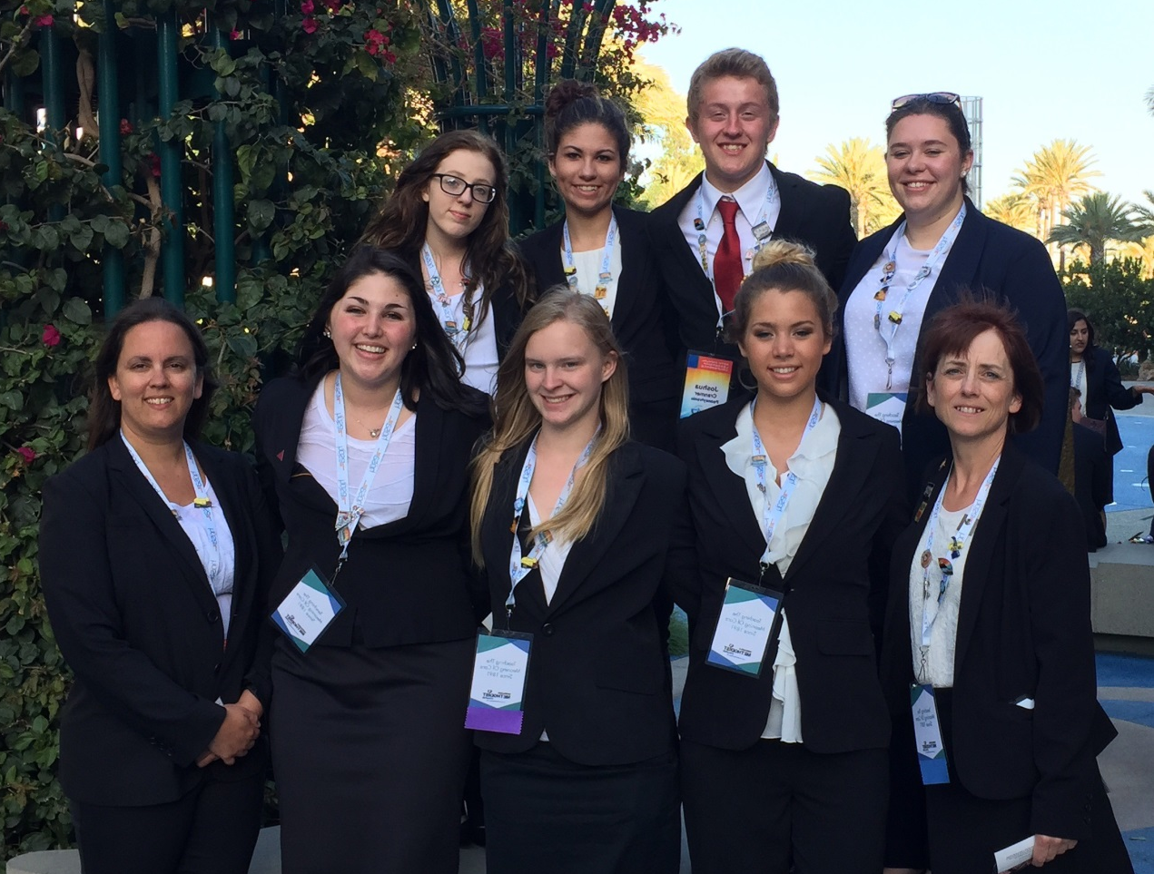

Slide 14
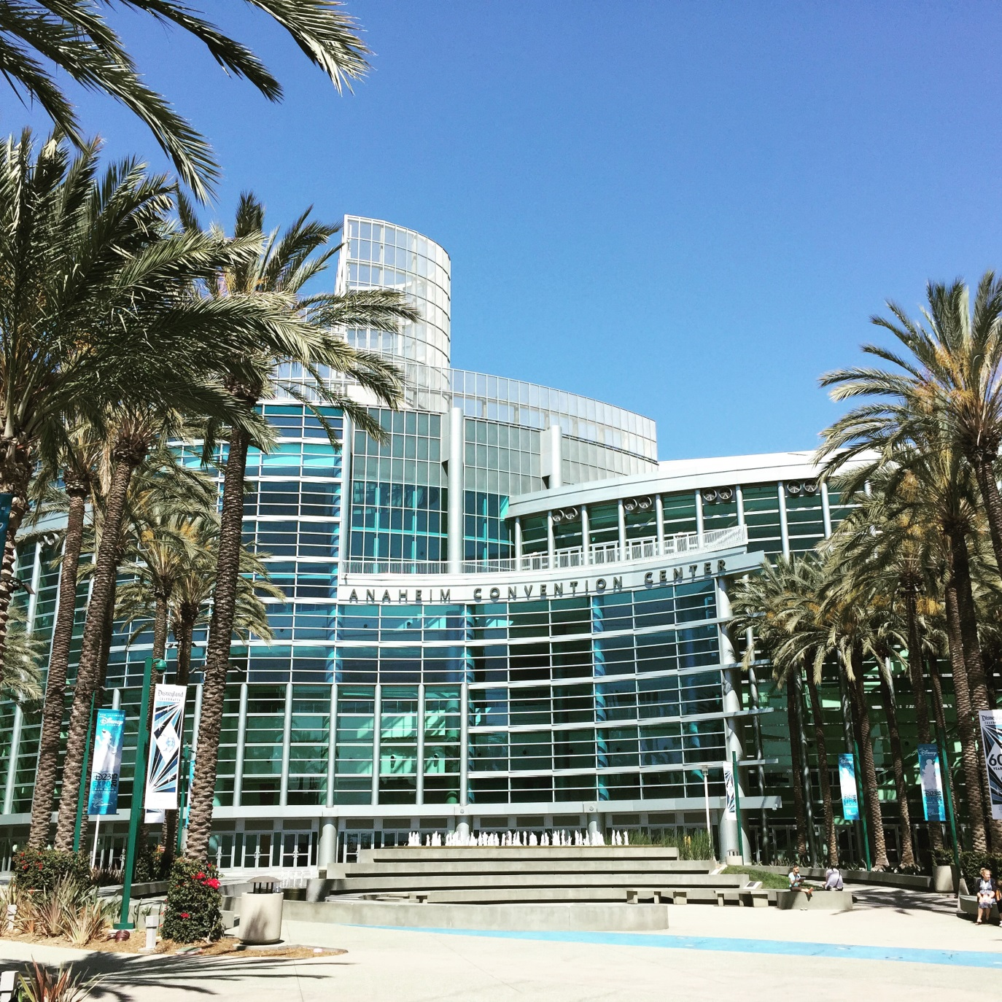

Slide 15
Opening Session NLC 2014-2015

Slide 16
NLC
Attendees – 8,550
Competitors – 6,375
Pennsylvania HOSA Medals Achieved
1 Gold
1 Silver
2 Bronze

Slide 17
Brittany Reitler - BCAVTS Gold Medal Personal Care Technician

Slide 18
See you in Tennessee 2016

